Slide 1
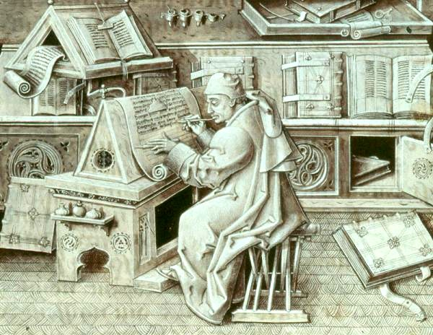
Proverbs Ch. 5 - 7
Drinking Water from Your Own Cistern

Slide 2

Question of the Day:
Who knows couples who have divorced over adultery?

Slide 3
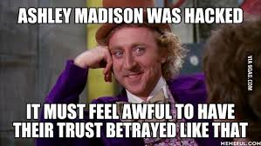
Explore in Proverbs 5 - 7:
  The dangers of adultery and joys of your spouse
  Habits that influence our lives
  The warning signs of the adulteress
Application:
  How do we adultery-proof our marriage?

Slide 4

Proverbs 5
What does the adulteress sound like?
What is the end result of having sex with her?
What is the prescription suggested by Proverbs?
Why is physical intimacy an important part of marriage?

Slide 5
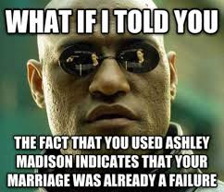
Proverbs 6
Who would you co-sign a loan for?
How do we recognize a “scoundrel and villain”?
Why are these 7 things hated by God and society?
What are some additional reasons given to not commit adultery?

Slide 6
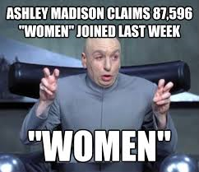
Proverbs 7
What is the simple youth doing when he is approached?
How does the adulteress entice the youth?
Why is it a “highway to the grave”?

Slide 7

Application
How does temptation happen in our society?
What are the signs we are developing secrets in our marriage?
How do we keep our marriages engaged and in tip top shape?

