Slide 1
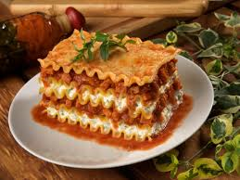
MAMA MIA,
I AM HUNGRY!!!
EXODUS 15:22 – 16:36

Slide 2
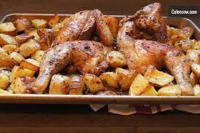
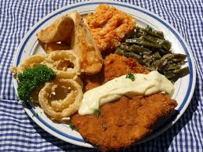
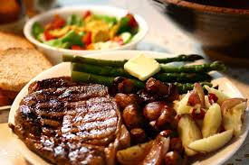
MAMA MIA, I AM HUNGRY!!!
What qualifies as a “home cooked meal” in your house?

Slide 3
MAMA MIA, I AM HUNGRY!!!
After the miracle at the Yam Suph, God leads Moses and the Israelites into the desert
  7 stories of the journey to meet God at Mt. Sinai
  Each follows a particular literary pattern:
    Problem, Speech, Deliverance, Lesson, Journey or Memorial
Discover whether the experience of the Israelites in the desert is analogous to ours and two things we can apply to our lives:
  What do we do when things are going as planned?
  How do we know when our own desires lead us astray?

Slide 4
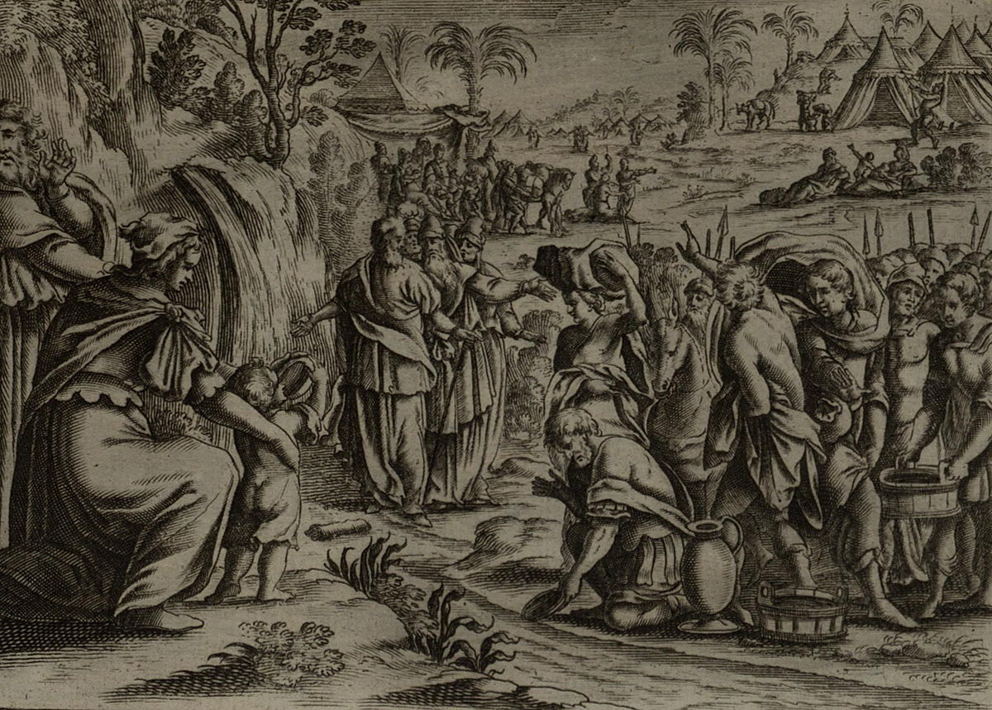
MAMA MIA, I AM HUNGRY!!!
Read 15:22 – 27
What was the problem and what did the people do?
What was the response by Moses? What was the response by God?
What does the narrator say the purpose of the event was?
How would you compare God’s teaching tactics here to ours as parents?

Slide 5
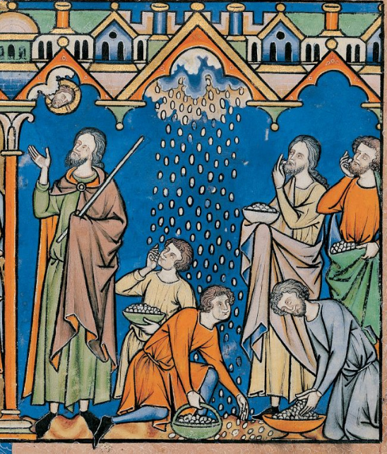
MAMA MIA, I AM HUNGRY!!!
Read 16:1 - 16
Who are the Israelites accusing and why?
What is the response of Moses and Aaron to them?
What is God’s response?
How would you describe the provision God provides for them?
What kind of divine priorities does this point to?

Slide 6
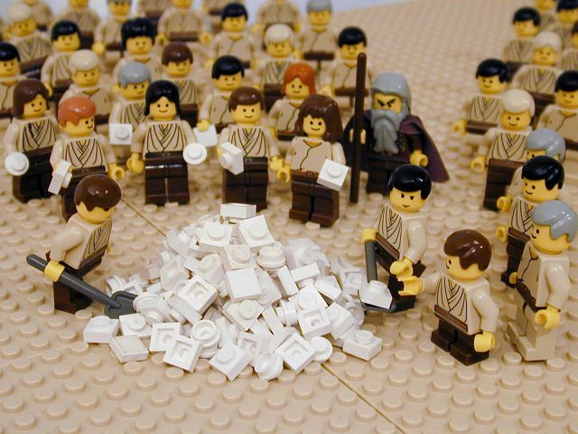
MAMA MIA, I AM HUNGRY!!!
Read 16:17 - 36
What do the Israelites try to do?
Why doesn’t this work?
Why doesn’t God give them food on the seventh day?
What else do the Israelites do to commemorate the occasion?

Slide 7
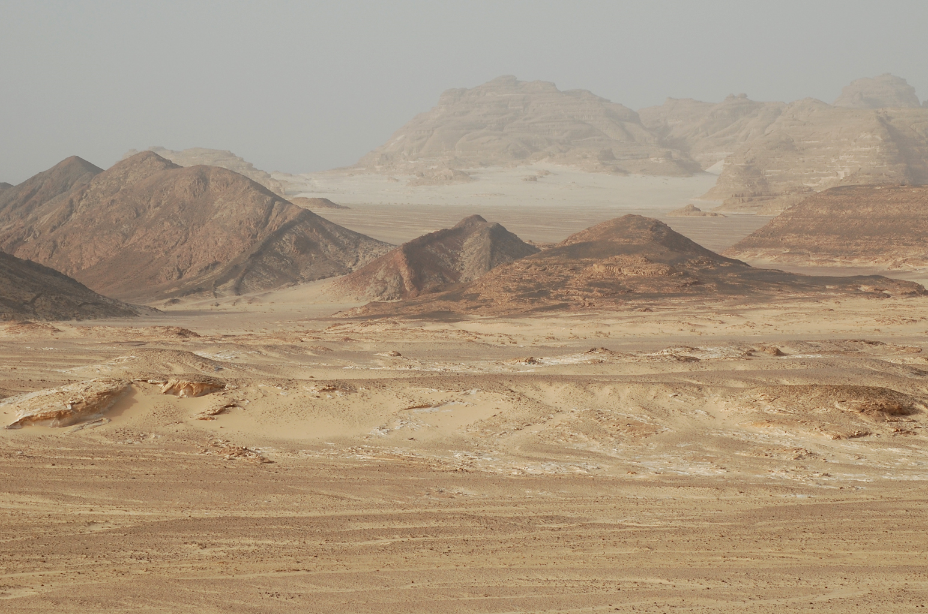
MAMA MIA, I AM HUNGRY!!!
We are tested just like them, often in ways we don’t understand
  What challenges do we deal with everyday?
  What does a healthy response look like?
We must beware of deciding based on our “hunger”
  How do we know when our own desires are ruling our decisions?
  What can we do to ensure this DOESN’T happen?

