Slide 1
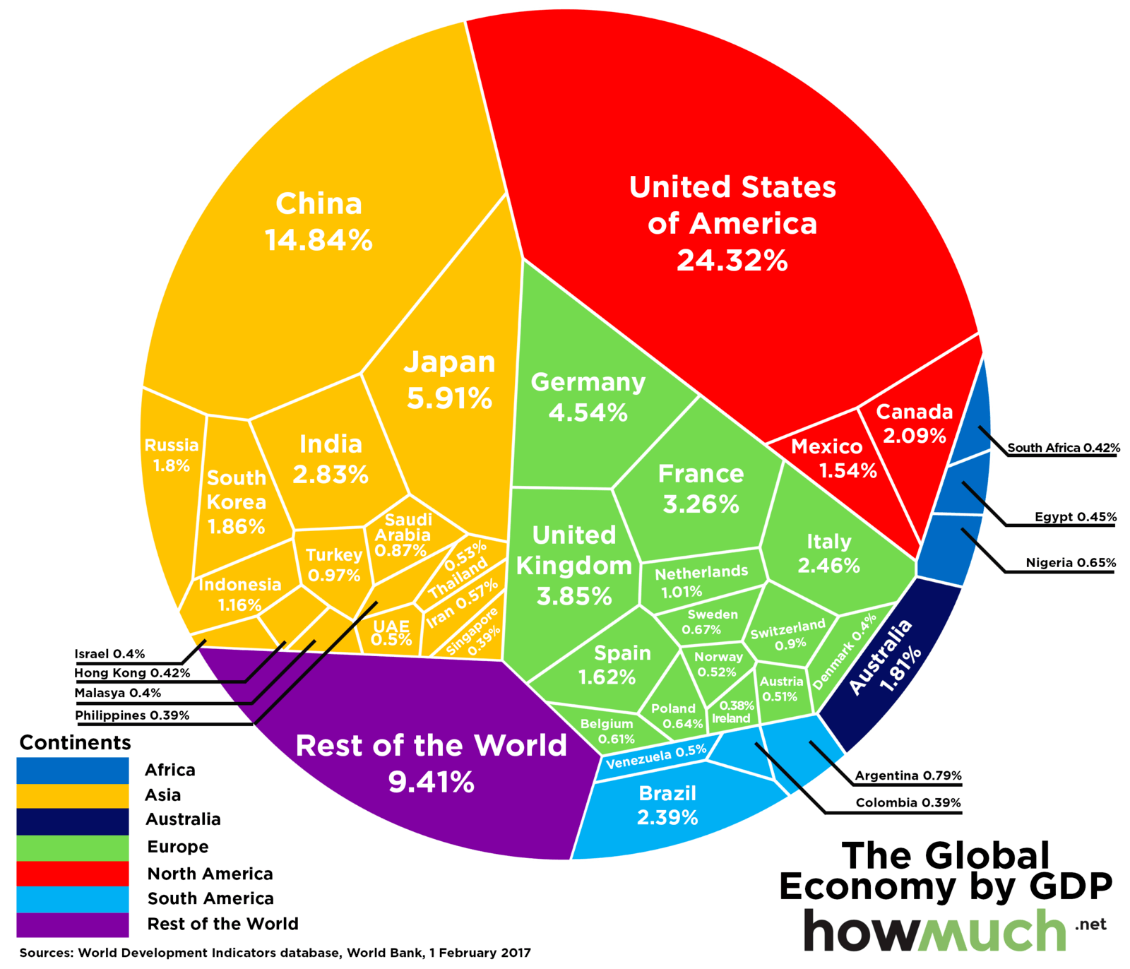
The Divine
Economy
EXODUS 32 - 34
WWW.THEOLOGICALSTRAYDOGS.COM

Slide 2
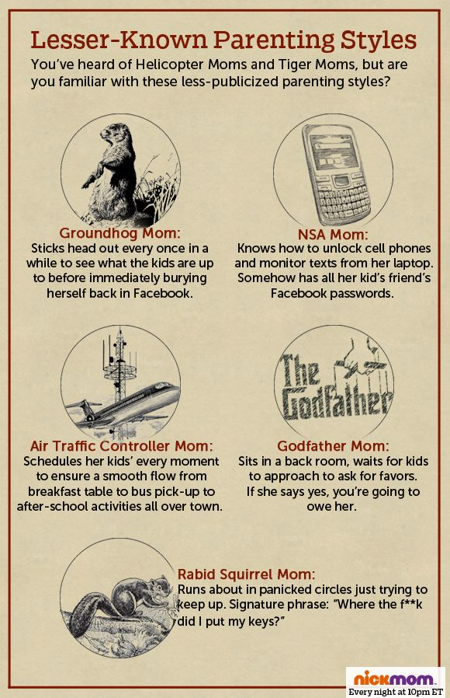
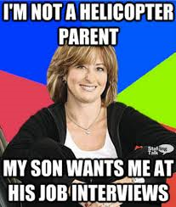
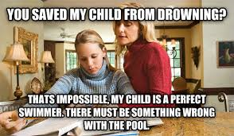
The Divine Economy
Any helicopter parents here?

Slide 3
The Divine Economy
After the rescue from Egypt, God leads Moses and the Israelites into the desert
  7 stories of the journey to meet God at Mt. Sinai
  Each follows a particular literary pattern:
    Problem, Speech, Deliverance, Lesson, Journey or Memorial
Explore the spiritual dynamics of their/our relationship with God:
  How should we act knowing that God has prepared our spiritual path?
  Do we have a responsibility to others as receptors of God’s grace? What does that look like?

Slide 4
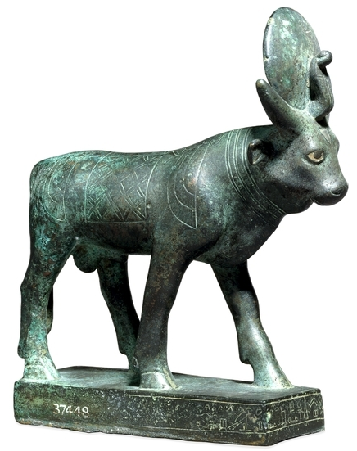
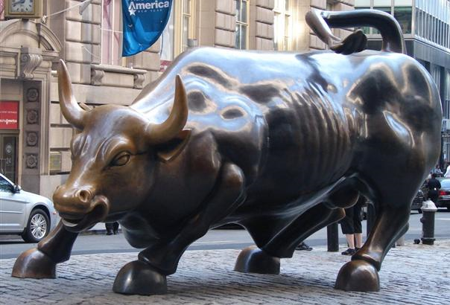
What is Taking So Long?!?!
Egyptian god, Apis
Read Exodus 32:1 - 8
What is the Israelites’ motivation in making the idol?
How does Aaron describe the idol in verse 4?
What is the dedication of the idol accompanied by?
Is the calf a new god, a substitute for Moses, or a stand-in for YHWH?
What is God’s reaction from Mt. Sinai?
What are the implications for leaders here?
A modern interpretation

Slide 5
Mediation and Forgiveness
Read Exodus 32:9 – 14, 30 - 35
What is the consequence God sets for the Israelites?
How does Moses react? What is his argument to NOT destroy them?
Does God change his mind?
What are the consequences of the Israelites’ sin?
How would you compare Moses leadership versus Ex. 4:10-13?
What drives us to intercede on others’ behalf?

Slide 6
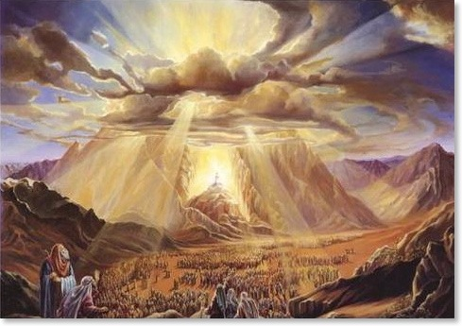
Re-establishing Relationship
Read Exodus 34:4 - 10
What is Moses’ request?
What is God’s response?
How would you describe the relationship God offers to the Israelites?
Who is performing the wonders?

Slide 7
The Divine Economy
God acts on our behalf
We do something stupid
Restoration of relationship
Mediation / atonement
God saves Israel from Egypt
Israel makes golden calf
Moses intervenes
Giving of the Law at Mt. Sinai
Incarnation
We sin
Jesus provides atonement
Redemption / Sanctification

Slide 8

What does this mean to me?
I don’t have to worry about Christmas decorations
  When we know God is preparing the way for us, how does that change how we act, make decisions, etc?
We have a responsibility for others like Moses
  When does leading become manipulation?
  What does positive leadership look like for our families?
  What does positive leadership look like for our class?
Takeaway for this week: God’s provision should spur us to act on others’ behalf – how can I act like Moses (or Jesus) this week?

Slide 9
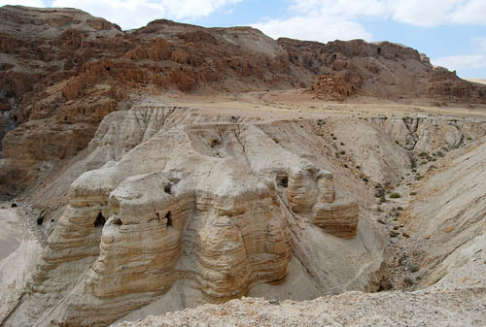
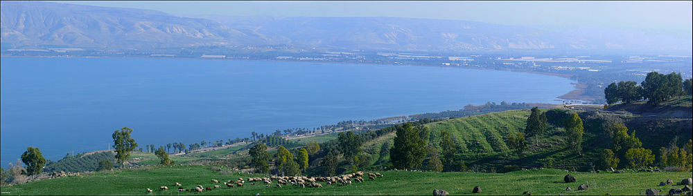
Next Week:
Jewish Foundations of the New Testament
Explore what people in the first century thought and believed about their life, God, and Jesus
Apply what we learn to reading the Bible
Grow a deeper relationship with God by wrestling with his Word on a deeper level
Homework for next week:
Read 1 Kings 18:20 – 46
What happened after Elijah kills the prophets of Baal?

