Slide 1
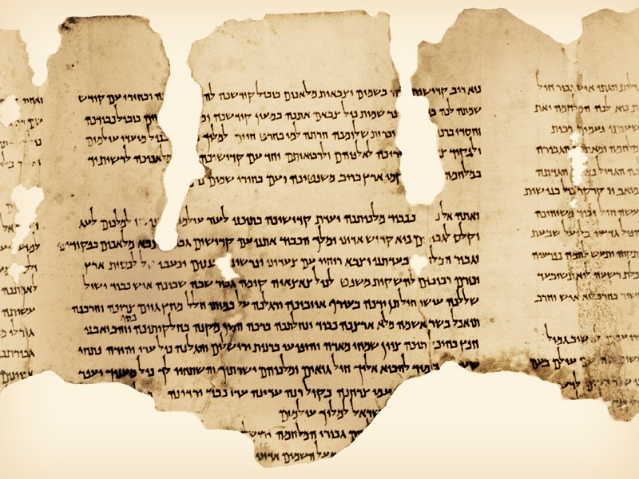
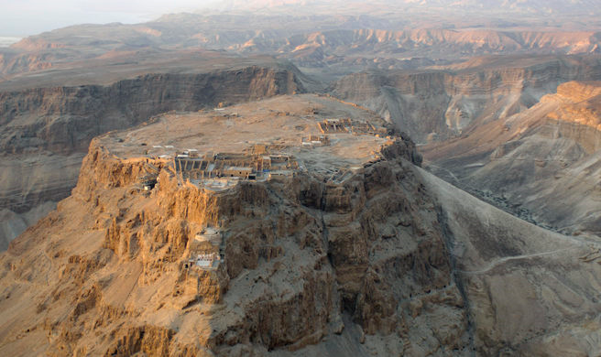
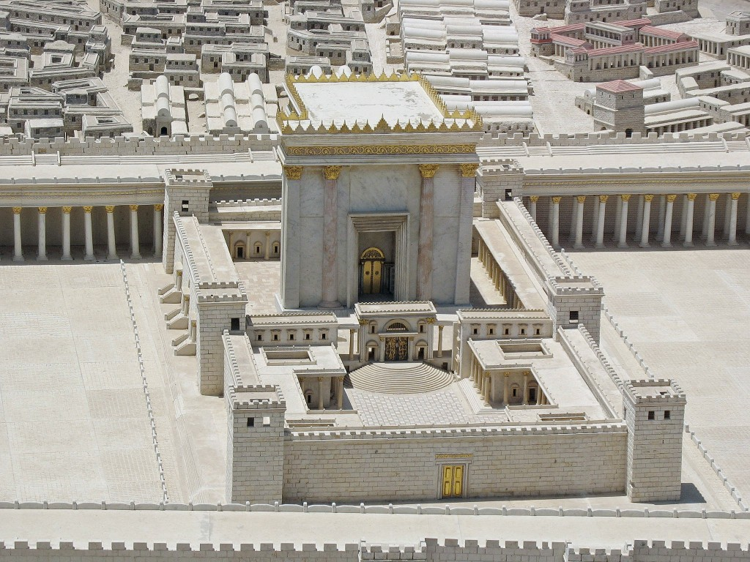
The Jewish foundations of the New Testament
Class IX – Practice What You Preach
March 18, 2017
www.theologicalstraydogs.com

Slide 2
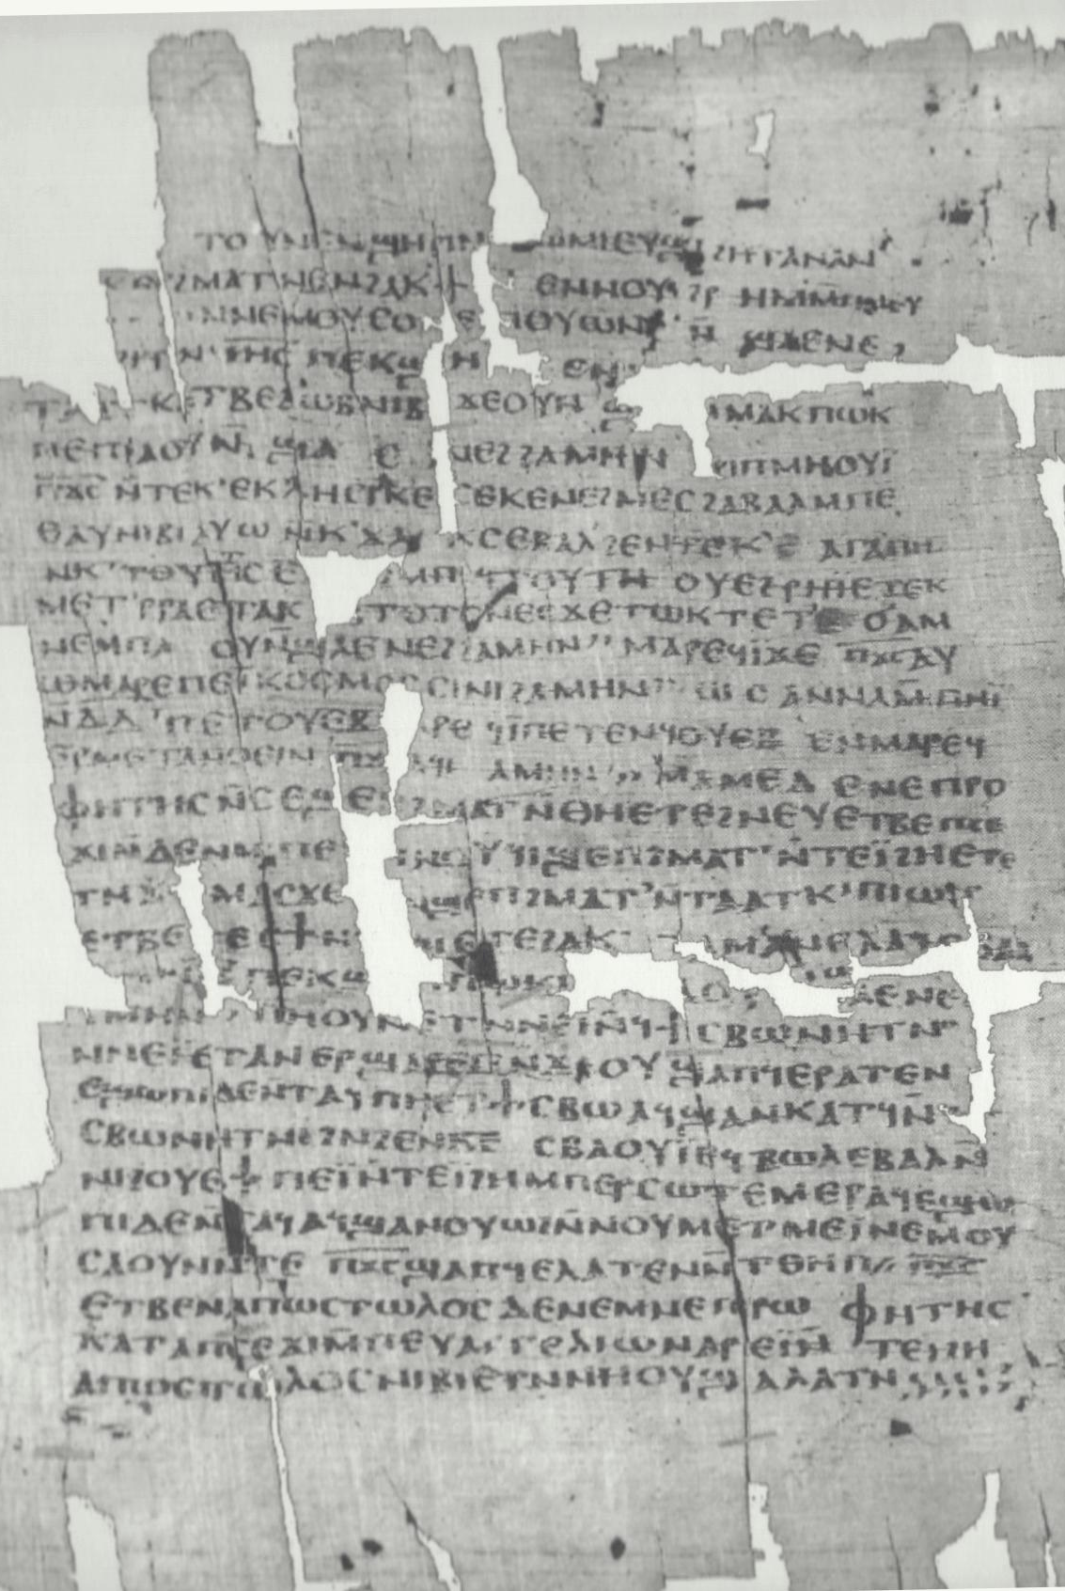
An Introductory Reading
The Didache or Teaching of the 12 Apostles (1st -2nd c. CE)
There are two ways, one of life and one of death; and great is the difference between the two ways.
This is the way of life: “First, you shall love God who made you; secondly, your neighbor as yourself; and whatever you would not like done to you, do not do to another.”
The teaching of these words is as follows: “Bless those who curse you, and pray for your enemies, and fast for those who persecute you.” For what is the merit of loving those who love you? Do not even the pagans do this? But, “love those who hate you,” and you will not have an enemy. “Abstain from carnal desires.” “If anyone strikes you on the right cheek, turn the other to him,” and you will be perfect. “If anyone forces you to go one mile with him, go two.” “If anyone takes your cloak, give him also your tunic.” If anyone takes what is yours, do not demand it back, for you have no power.

Slide 3
Election and Covenant: Quick Review
The Rabbis believed that the election of Abraham (and thereby the entire Jewish ethnic nation) was the foundation of their religion
The existence of the relationship between Israel and YHWH is presupposed by all
The existence (and acceptance) of this fact of election meant Jews were called to a special type of relationship
God’s gracious acts preceded the obligations to follow Torah
The presence of these commandments/obligations was positive, not a burden
The intent was for Israel to act of worship with sincere devotion, not just obey to fulfill

Slide 4
Election and Covenant
The failure to faithfully observe the commandments is sin. For each of these transgressions God had appointed an appropriate way to show repentance
There is no doctrine of “original sin” in Judaism – people do sin, but these are personal choices for which they are responsible, not innate in nature
But sin has repercussions that affect those later (one of the consequences of the Garden of Eden was death, for example)
Yet God always seeks to favor mercy over justice because of their existing relationship
God always stands ready to forgive because of grace

Slide 5
Election and Covenant
Atonement/repentance reflects an issue of personal piety, not theological standing with God
So what does it mean to be “righteous” (tsadaq):
  “[T]hose who accept the covenant, which carries with it God’s promise of salvation, accept also the obligation to obey the commandments given by God in connection with the covenant. One who accepts the covenant and remains within it is ‘righteous’, and that title applies to him both as one who obeys God and as one who has a ‘share in the world to come’, but the former does not earn the latter.” – E.P. Sanders, Paul and Palestinian Judaism, pg. 204
Those who have rejected the covenant and no longer follow Torah have “thrown off the yoke”
But repentance at the end of life can undo a lifetime of throwing off the yoke, and vice-versa.

Slide 6
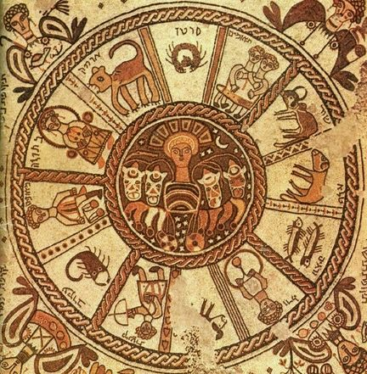
Last Week’s Homework
Read Matthew 23
Who are the “woes” directed to?
What are the criticisms Jesus directs at them?
Based on our reading today, would the rabbis have agreed with Jesus?
So how do we interpret the meaning here? Are Jesus’ indictments selective in its accusations? Are they reflective of the church’s experience at the time of Matthew’s writing? Are they true for both Judaism and Christianity, ethically speaking?

Slide 7
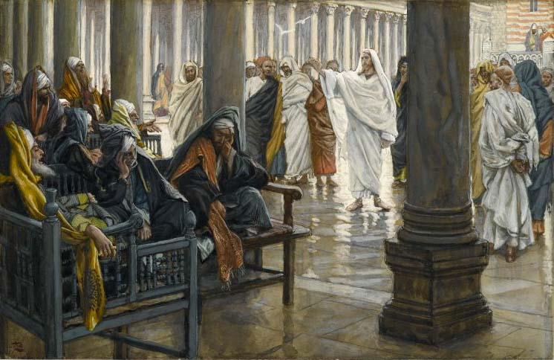
Last Week’s Homework
A few ideas to guide us:
This is an intra-Jewish dialogue, much like the Essenes and the Temple
The meaning of a text cannot mean to us what it didn’t mean then
Be sensitive to our own presuppositions (good and bad)
Pay attention to the overall flow of the book – don’t proof-text; ask what the author is doing

Slide 8
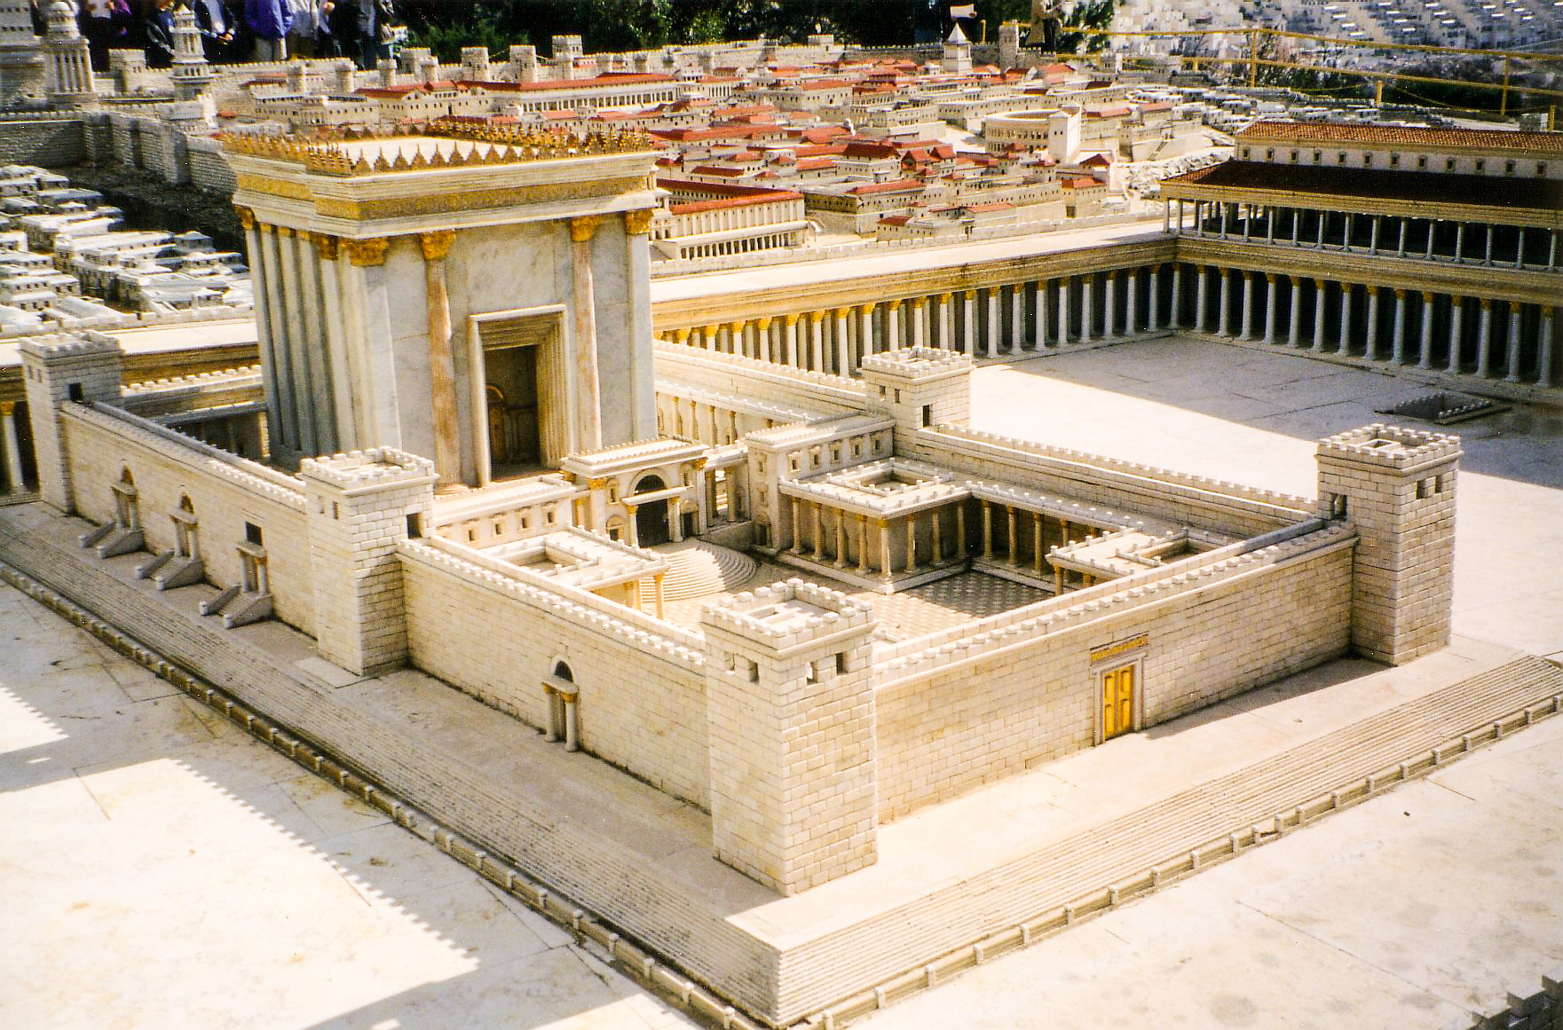
Election and Covenant
Jerusalem Temple as covenant symbol
Importance of the Temple as a national/ethnic/religious symbol
Herod’s Temple

Slide 9
Next Week’s Homework
Read Mark 14:53 - 65
What is the major charge against Jesus discussed here (also found in Matthew)?
Why is this such a major charge and affront to Jewish belief?
Did Jesus actually say it? What did he mean?
More online at:
www.theologicalstraydogs.com

